Slide 1
Algorithm Assignment
NAME: Lotanna Okeke
MAT NO.: 20120612038
COURSE TITLE: CSC 102

Slide 2

Algorithm to find the:
Root of a quadratic equation: A$x^{2}+Bx+C=0$

Slide 3
INPUT A
INPUT B
INPUT C
COMPUTE D = B^2-4AC
COMPUTE X1 = (-B+(D)^0.5)/2A
COMPUTE X2 = (-B-(D)^0.5)/2A
IF D=0 THEN
PRINT X1
ELSE
PRINT X1 AND X2

Slide 4
START
INPUT A,B,C
D = B^2-4*A*c
X1 = -B +(D^0.5)
X2 = -B-(D^0.5)
FALSE
IS D=0
TRUE
PRINT X1 & X2
PRINT X1
END

Slide 5

Algorithm to find the:
Root of a cubic equation: ${Ax}^{3}$+ ${Bx}^{2}+Cx+D=0$

Slide 6
INPUT A
INPUT B
INPUT C
INPUT D
COMPUTE J=(-1)^0.5
COMPUTE A1 = B/A
COMPUTE A2 = C/A
COMPUTE A3 = D/A
COMPUTE Q = (3*A2 – A1^2)/9
COMPUTE R = ((9*A1*A2) – (27*A3) – (2*A1^3))/54
COMPUTE S = (R + (Q^3 + R^2)^0.5)^(1/3)
COMPUTE T = (R - (Q^3 + R^2)^0.5)^(1/3)
COMPUTE X1 = S+ T - 1/3*A1
COMPUTE X2 = -0.5(S + T) – (1/3 * A1) + (0.5*J*(3^0.5)*(S – T))
COMPUTE X3 = -0.5(S + T) – (1/3 * A1) - (0.5*J*(3^0.5)*(S – T))
PRINT X1 AND X2 AND X3

Slide 7

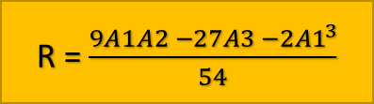

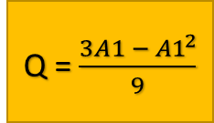
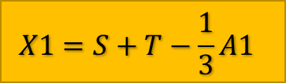
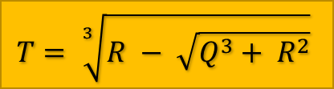
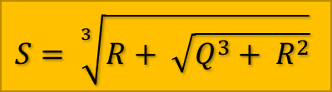
START
A1=B/A
A2 = C/A
A3 = D/A
Q = $\frac{3A1 − {A1}^{2}}{9}$
INPUT A,B,C,D
$$T= \sqrt[3]{R − \sqrt{Q^{3}+ R^{2}}}$$
$$S= \sqrt[3]{R+ \sqrt{Q^{3}+ R^{2}}}$$
R = $\frac{9A1A2 −27A3 −2{A1}^{3}}{54}$
$$X1=S+T−\frac{1}{3}A1$$
$$X2=−\frac{1}{2}\left(S+T\right)−\frac{1}{3}A1+\frac{1}{2}i\sqrt{3}(S−T)$$
TRUE
IS (S-T)=0
$$X3=−\frac{1}{2}\left(S+T\right)−\frac{1}{3}A1−\frac{1}{2}i\sqrt{3}(S−T)$$
FALSE
PRINT X1,X2
PRINT X1,X2,X3
END

Slide 8
Algorithm to find the:
Find the largest of three numbers

Slide 9
INPUT A
INPUT B
INPUT C
COMPUTE D = A-B
COMPUTE E = A-C
COMPUTE F = B-C
IF D>=0 AND E>=0 THEN
PRINT A
ELSE
IF D<=0 AND F>=0 THEN
PRINT B
ELSE
PRINT C

Slide 10
START
INPUT A,B,C
D=A-B
E=A-C
F=B-C
IS D>=0 AND E>=0
TRUE
FALSE
TRUE
IS D<=0 AND F>=0
FALSE
PRINT A
PRINT B
PRINT C
END

Slide 11
Algorithm to find the:
Find the GCD of two numbers

Slide 12
INPUT A
INPUT B
IF A=0 OR B=0 THEN
PRINT 0 ISNT A NATURAL NUMBER
ELSE
COMPUTE R1 = RANGE(1,A+1)
COMPUTE R2 = RANGE(1,B+1)
IF C IS IN R1 AND R2 THEN
IF A%C=0 AND B%C=0 THEN
F=C
PRINT F

Slide 13
START
INPUT A,B
TRUE
IS A=0 OR B=0
FALSE
R1=RANGE(1,A+1)
R2=RANGE(1,B+1)
PRINT ZERO ISN’T A NATURAL NUMBER
FALSE
IS C IN RI AND R2
TRUE
FALSE
IS A%C=0 AND B%C=0
EXIT FROM LOOP
TRUE
F = C
END
PRINT F

Slide 14
Algorithm to find the:
Find the LCM of two numbers

Slide 15
INPUT A
INPUT B
COMPUTE PROD = A*B
COMPUTE R1 = RANGE(1, PROD+1)
IF C IS IN R1 THEN
IF C%A = 0 AND C%B = 0
D=C
BREAK
PRINT D

Slide 16
START
INPUT A,B
PROD = A*B
R2=RANGE(1,PROD+1)
FALSE
IS C IN R1
TRUE
FALSE
IS C%A=0 AND C%B=0
EXIT FROM LOOP
TRUE
D = C
PRINT D
TRUE
IS C%A=0 AND C%B = 0
FALSE
END

Slide 17
Algorithm to find the:
Find the factorial of a number

Slide 18
INPUT A
COMPUTE D = 1
COMPUTE R1 = RANGE(1, A+1)
IF A<0 THEN
PRINT A ISNT A WHOLE NUMBER
ELSE
IF B IS IN R1 THEN
D = D*B
PRINT D

Slide 19
START
INPUT A
RI=RANGE(1, A+1)
PRINT RENENTER A WHOLE NUMBER
TRUE
IS A<0
FALSE
FALSE
IS B IN R1
TRUE
D = D*B
END
PRINT D
EXIT FROM LOOP

